Slide 1
Distributed and Parallel Computing for Big Data
Pravin Y Pawar

Slide 2
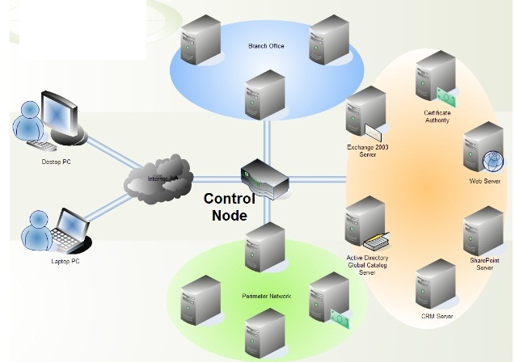
Distributed Computing
Need
In distributed computing,
Multiple computing resources are connected in network and computing tasks are distributed across these resources
Results into increase in speed and efficiency of system
Faster and more efficient than traditional methods of computing
More suitable to process huge amounts of data in limited time

Slide 3
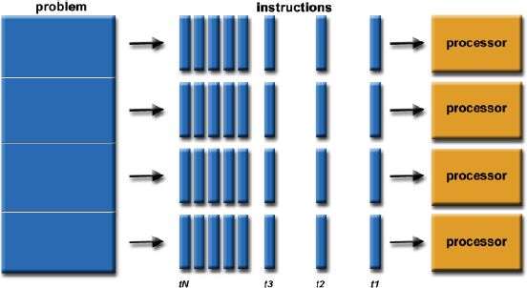
Parallel Computing
In Parallel Computing,
Additional computational resources are added to the same system to improve the processing capability of system
Helps in dividing complex computations into subtasks, which can be handled individually by processing units that are running in parallel
Multiple computing systems are running parallel
Concept is processing capability will increase with the increase in the level of parallelism

Slide 4
Techniques for High Data Processing
Method | Description | Usage
Cluster or Grid Computing | Based on a connection of multiple servers in a network Servers share the workload among them Systems can be homogeneous or heterogeneous | Used in Hadoop Cluster can be created by hardware components that were acquired long back
Massively Parallel Processing (MPP) | Single machine working as grid Capable of handling activities of storage, memory and computing | Used in Data warehouses EMC Greenplum ParAccel
High-Performance Computing (HPC) | Known to offer high performance and scalability by using IMC Suitable for processing floating-point data at high speeds | Used to develop specialty and custom applications for research where results is more valuable than cost

Slide 5
Comparing Parallel and Distributed Systems
Distributed System | Parallel System
Independent, autonomous system connected in a network accomplishing specific tasks | Computer system with several processing units attached to it
Coordination is possible between connected computers with own memory and CPU | A common shared memory can be directly accessed by every processing unit in a network
Loose coupling of computers connected in network, providing access to data and remotely located resources | Tight coupling of processing resources that are used for solving single, complex problem

Slide 6
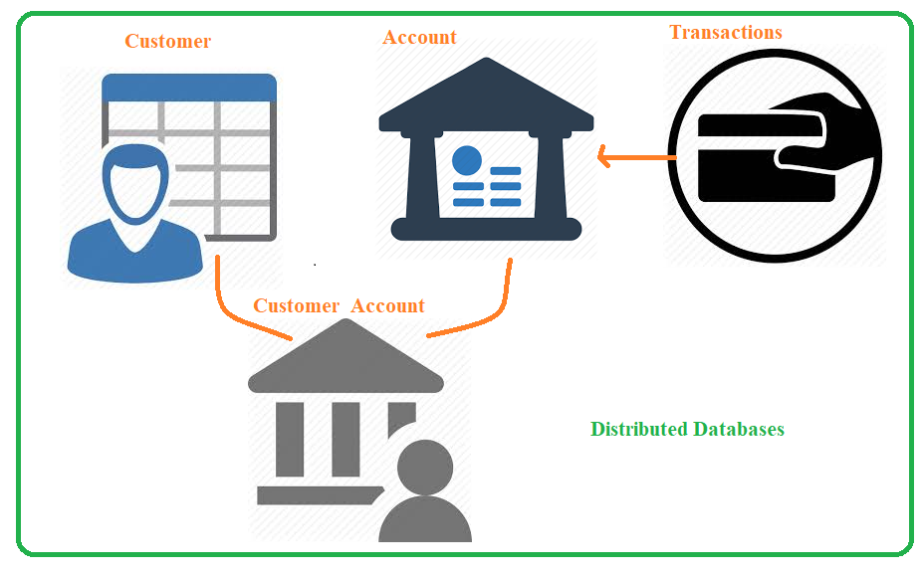
Data Models – Distributed Databases
Deal with tables and relations
Must have a schema for data
Implements data partitioning

Slide 7
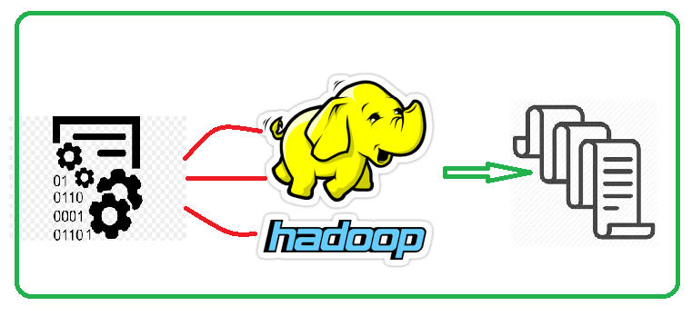
Data Models – Hadoop
Deals with flat files in any format
Operates on no schema for data
Divides files automatically in blocks

Slide 8
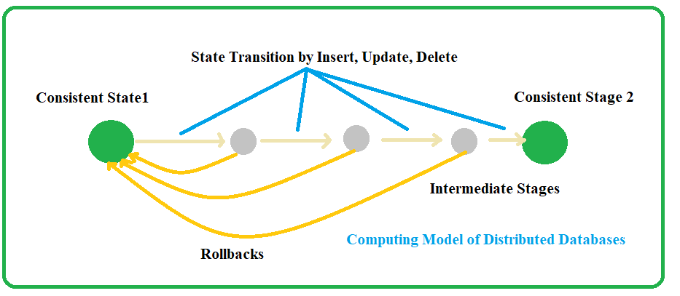
Computing model – Distributed Databases
Generate notions of transaction
Implement ACID transaction properties
Allow distributed transactions

Slide 9
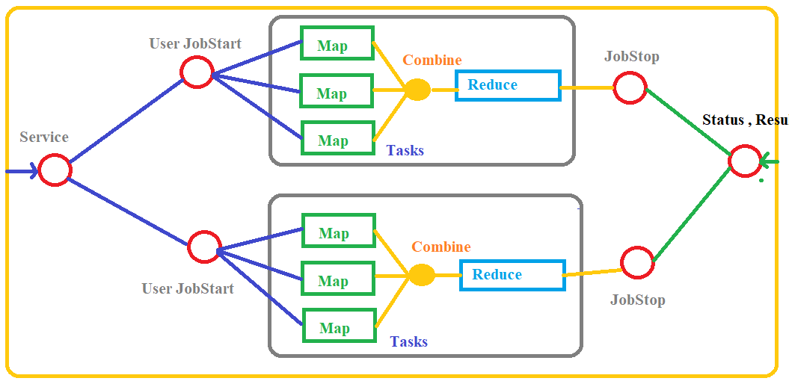
Computing model - Hadoop
Generates notions of a job divided into tasks
Implements MapReduce computing model
Considers every task either as a Map or a Reduce

Slide 10
Thank You!
In our next session: Apache Hadoop for Big Data

